Slide 1
What Your Family Thinks You Do
An Analysis of Hacking in Hollywood
Isaac Basque-Rice

Slide 2

WHOAMI
Isaac Basque-Rice
EDR Security Engineer @ Adarma
Recent Grad
UFO Guy
@IBRice101
They/Them

Slide 3

Why Care?
<- Your uncle watches movies
Hacking has been a mainstay in movies for over 40 years
Don’t care so much about accuracy in this talk
Notes:
Have you ever been chatting to a non-technical person and once you mention hacking they ask you if you can hack their bank account or whatever?
So Hacking depictions in films shape public perception of cybersecurity.
I’m interested in exploring how movie portrayals affect hacking culture and general perceptions

Slide 4
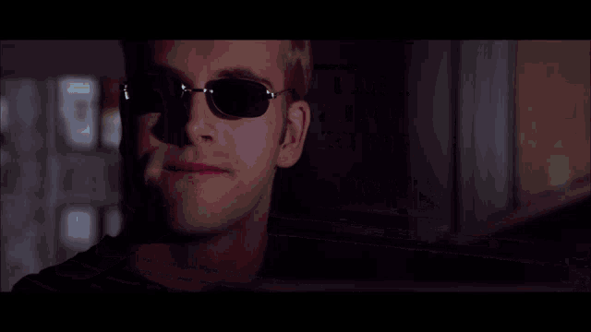
Introduction
Movie Hacking is ubiquitous in hacker culture
Not “Accurate” but why bother thinking about that?
Where does this leave us for this talk?
Notes:
Hard pressed to find someone here who doesn’t know any movies with hacking in them
Memes
NCIS characters using the same keyboard at the same time
”We’re in” “Throwing up a Firewall” etc. etc.
Often used as a joke
“is this accurate” has been done to death, I’m not interested in it really (apart from as something funny)
Reddit posts, YouTube videos with Samy Kamkar and MalwareUnicorn, articles, etc. its done
Not throwing up a video and talking through it
Puts us in an interesting position… we need to ask a different question
More accurately 2 questions…

Slide 5
1. How is Hacking Used on the Big Screen?
2. How do Movies Affect Both the Hacking Subculture and Culture More Widely?
Notes:
To answer these we need to start somewhere more basic… and that is:

Slide 6
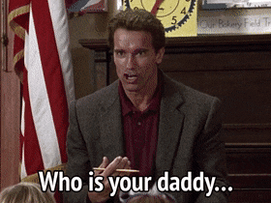
Who Are Movie Hackers and What Do They Do?
Notes:
If you’ll excuse the unfortunate Arnie quote I couldn’t get this out of my head…

Slide 7
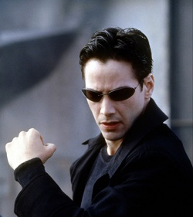
Forty Years of Movie Hacking by Damian Gordon
List of movies w/ info
Analysis of the actual hackers
Who is the average movie hacker?
Notes:
One of the first places I looked was Google Scholar
Either for legitimacy or a trauma response from my diss
Source considers implications of media representation of hackers
Only covers 1968 (!!!) to 2008 tho
Flawed in its artistic analysis (Bro calls documentaries “not movies” and discounts animated movies out of hand)
This paper gives us two things:
This list actually includes a couple of really good movies
Who the hackers are
what they do
didn’t have to watch 50 movies after work
Detailed analysis
Ages, jobs, heroes or villains. Etc.
Average hacker in movies:
Late 20s
Works in IT
Protagonist
Outsider attacker
Accuracy can be debated till the cows come home
Aren’t we all the main character?
This is the perspective most people have on us
(or the basement dwelling stereotype, that’s more incels and redditors now tho)

Slide 8
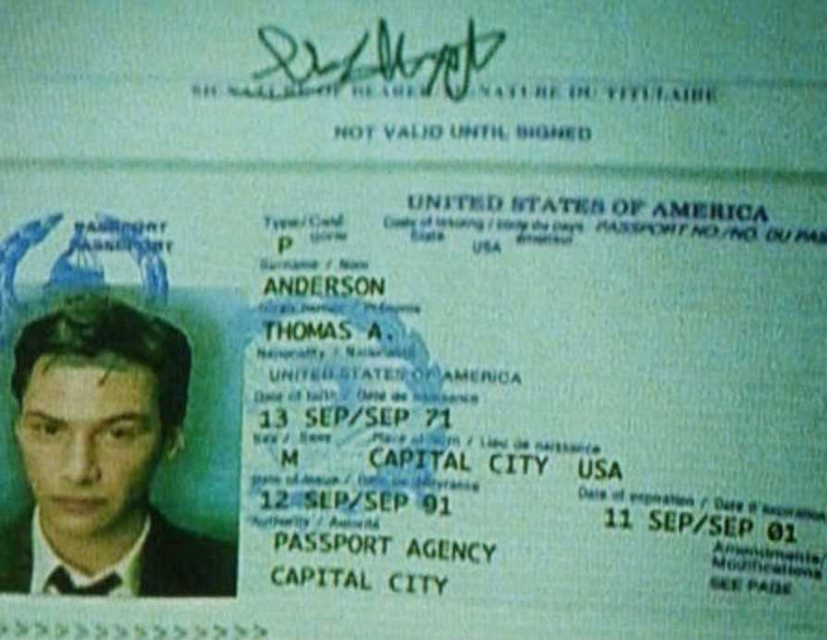
A quick aside…
Notes:
Neo’s passport says he was born in 1971 which would make him 52 years old now
Apparently… the average age of an infosec professional is 42 now
Neo fits the archetypal hacker almost exactly
The paper also fails to cover gender which is another issue with it…
I wouldn’t take it as gospel

Slide 9
Genre
Notes:
Gordon identifies 5 genres of film in which hackers appear
Will take a few moments to cover each of the genres he identifies
And the purpose of hackers in each
Clearing up a term:
“Genre film”
I may not mention it again but I think its good people know
Fit well-defined genres with pre-packaged audience
MCU films, horrors, rom-coms
Not every film here is a genre film but when you have hacking tropes being reused you’re bound to get some genre flicks in there too

Slide 10
Genres
Hacker
Heist
Heroic
Sci-Fi
TrueLife
Notes:
Genres:
movies exclusively about hackers and hacking
movies with robbery as the central plot
movies where regular individuals are compelled to perform extraordinary actions
Science Fiction movies featuring futuristic technology
movies depicting the adventures of real-life hackers

Slide 11
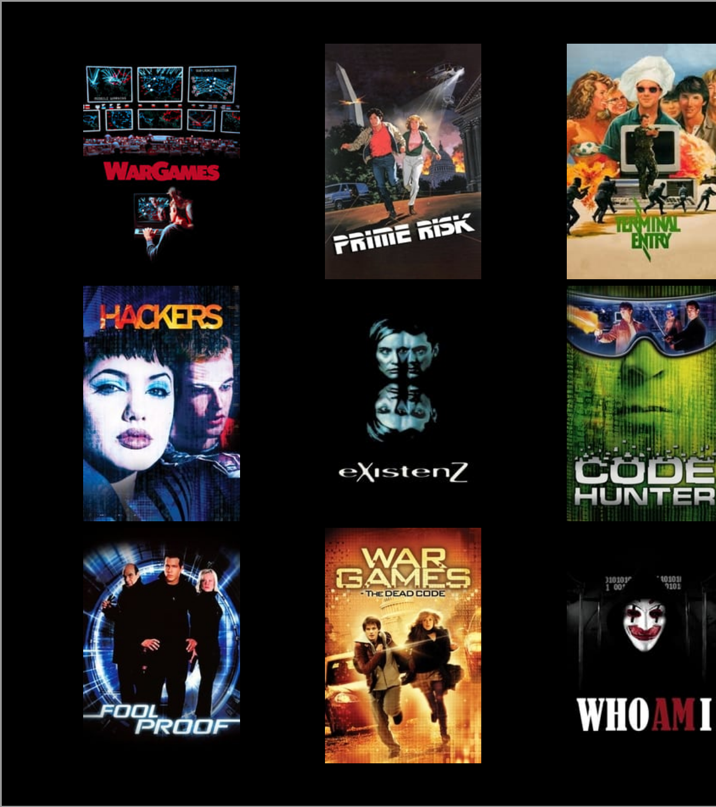
Genre: Hacker
Notes:
For what it's worth, I can only really see two films on there worth bothering to find, you can probably guess which ones.

Slide 12
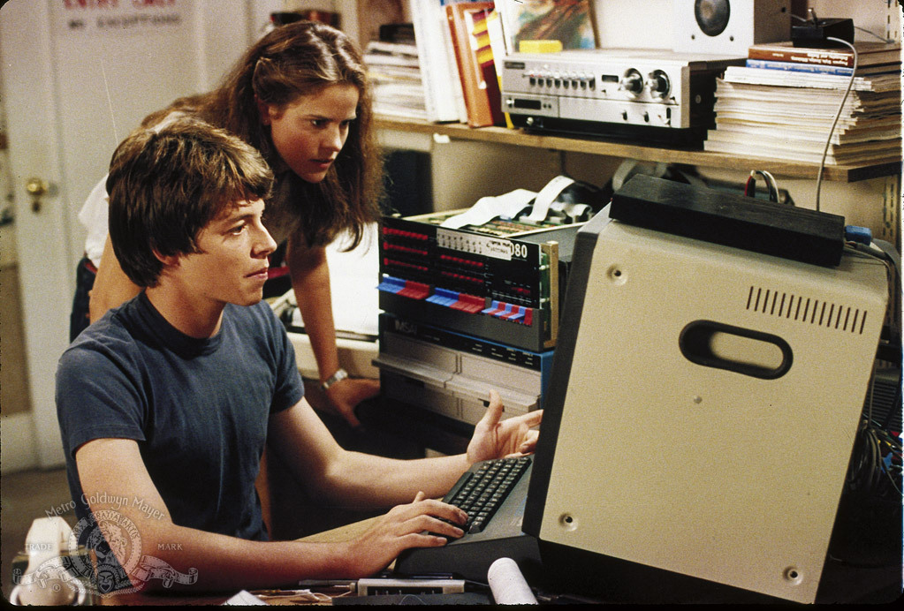
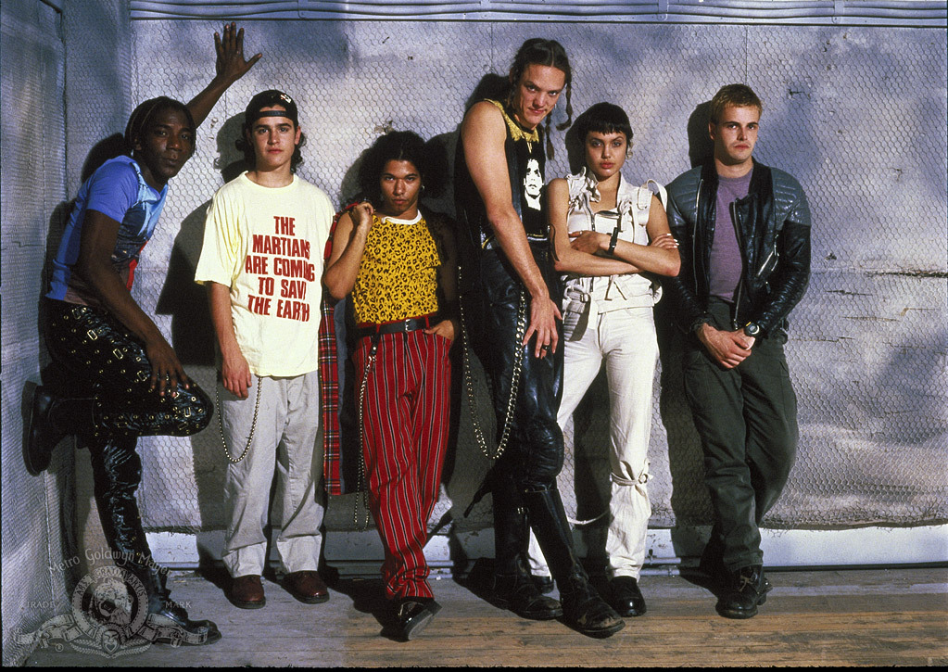
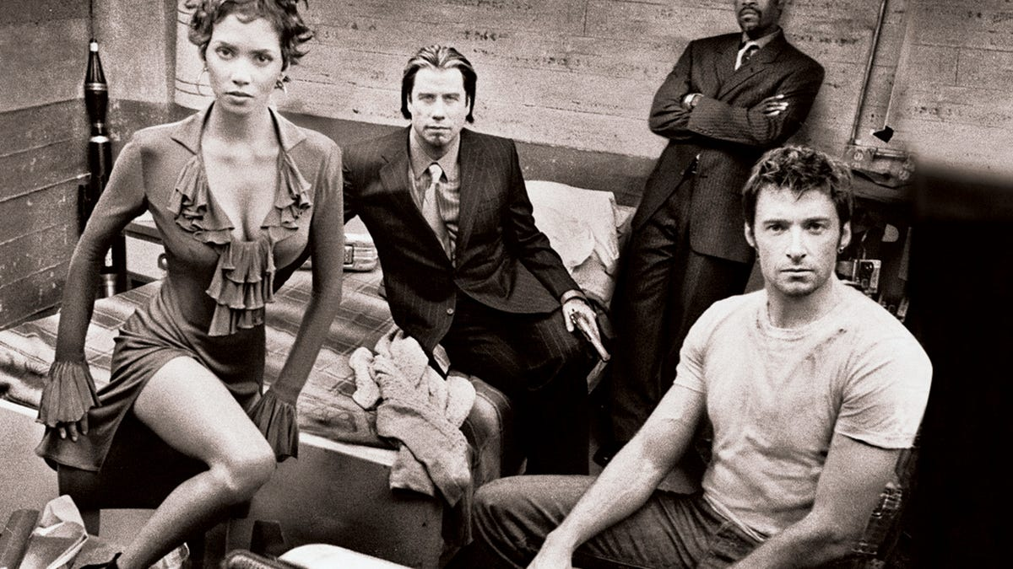
Genre: Hacker
Who are the characters?
Who is the audience?
What are the impact of these restrictions?
Notes:
Most obvious “genre” (if you can even call it that)
Characters:
Almost always protagonists
Cool clothes, crazy lingo, nerd fantasy type stuff
When they are antagonists they’re usually part of a wider org
Hackers: both pro-and antagonists are hackers, antag works for big company
Who Am I: antag works for the Russians
Audience:
Remember how I was taking about genre films having a pre-packaged audience?
These are hackers, computer nerds, outcast kids.
Means the way they can be portrayed is pretty restricted
Not many hacker films now really, imo because the audience isn’t there
Hacker culture has turned more profitable, more LinkedIn now I fear
If Film X is the 5th hacker flick in as many years and also the 5th to have the FBI as the Big Bad then something's up, right?

Slide 13
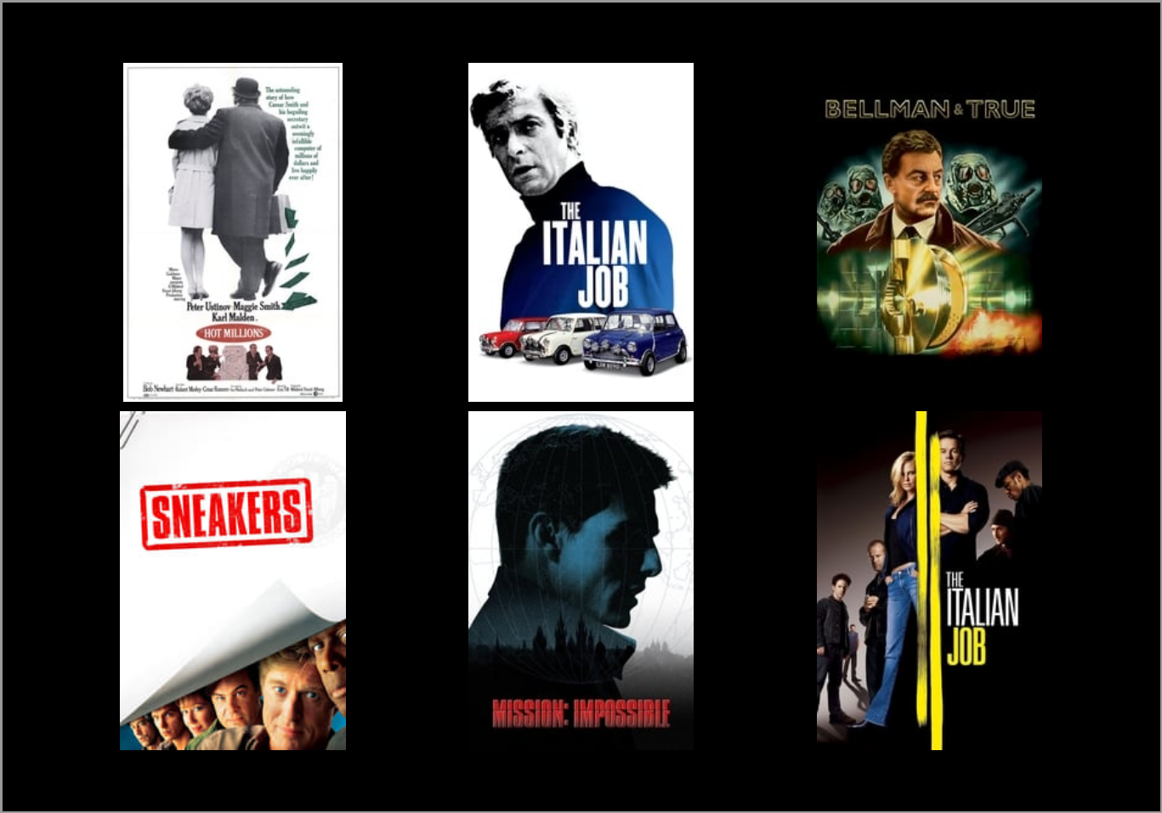
Genre: Heist
Notes:
Hackers just forward the plot
more like devices than characters here
Amalgamation of clichés and plot devices
Handwaving away technical limitations between audience and sick laser dodging
Genre also saw the birth of hacking in film
Hot Millions
Peter Ustinov’s Marcus Pendleton is a con man
Uses social engineering and physical tampering
Convinces people he’s a computer engineer called Cesar Smith
Sends himself checks all over Europe using the company account
Italian Job (1068)
Benny Hill (lol) plays Simon Peach (ooer)
Replaces tapes that run turin traffic light system
Fucks up traffic so they can continue the heist
Actually has character, which is good

Slide 14
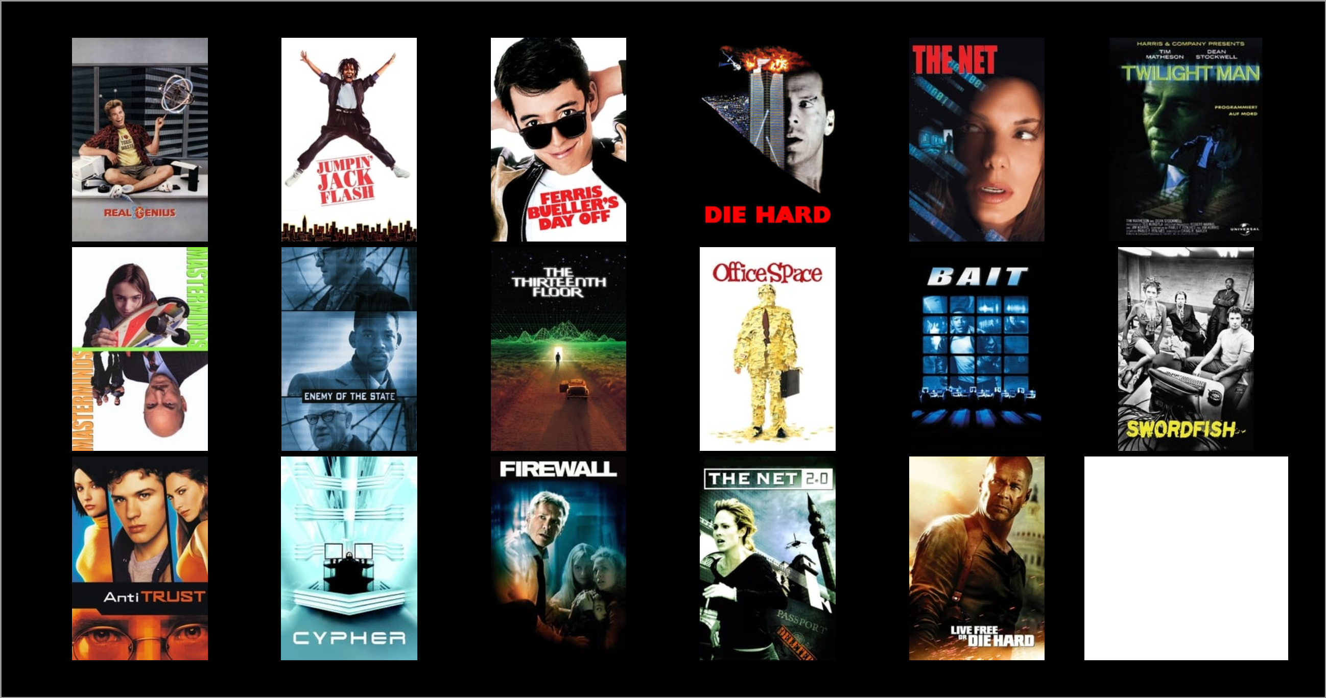
Genre: Heroic
Notes:
Not… really a genre lol
Not much in common between Office Space and Die Hard (apart from being set in an office ig)
Because of that, there aren’t many commonalities between ways hacking is used
Deleting absences from school in Ferris Bueller's Day off
Shutting down the Federal Reserve’s security in Bait
Pocketing fractions of cents from interest accrued by employer in Office Space
This is interesting to me though
Hacking becomes a magic wand
Used similarly to magic in fantasy
For heroes, helps the story
For villains (Hans Grüber in Die Hard), gets in the way
Imo this one trope is most responsible for the “can you hack into my bank account” schtick

Slide 15
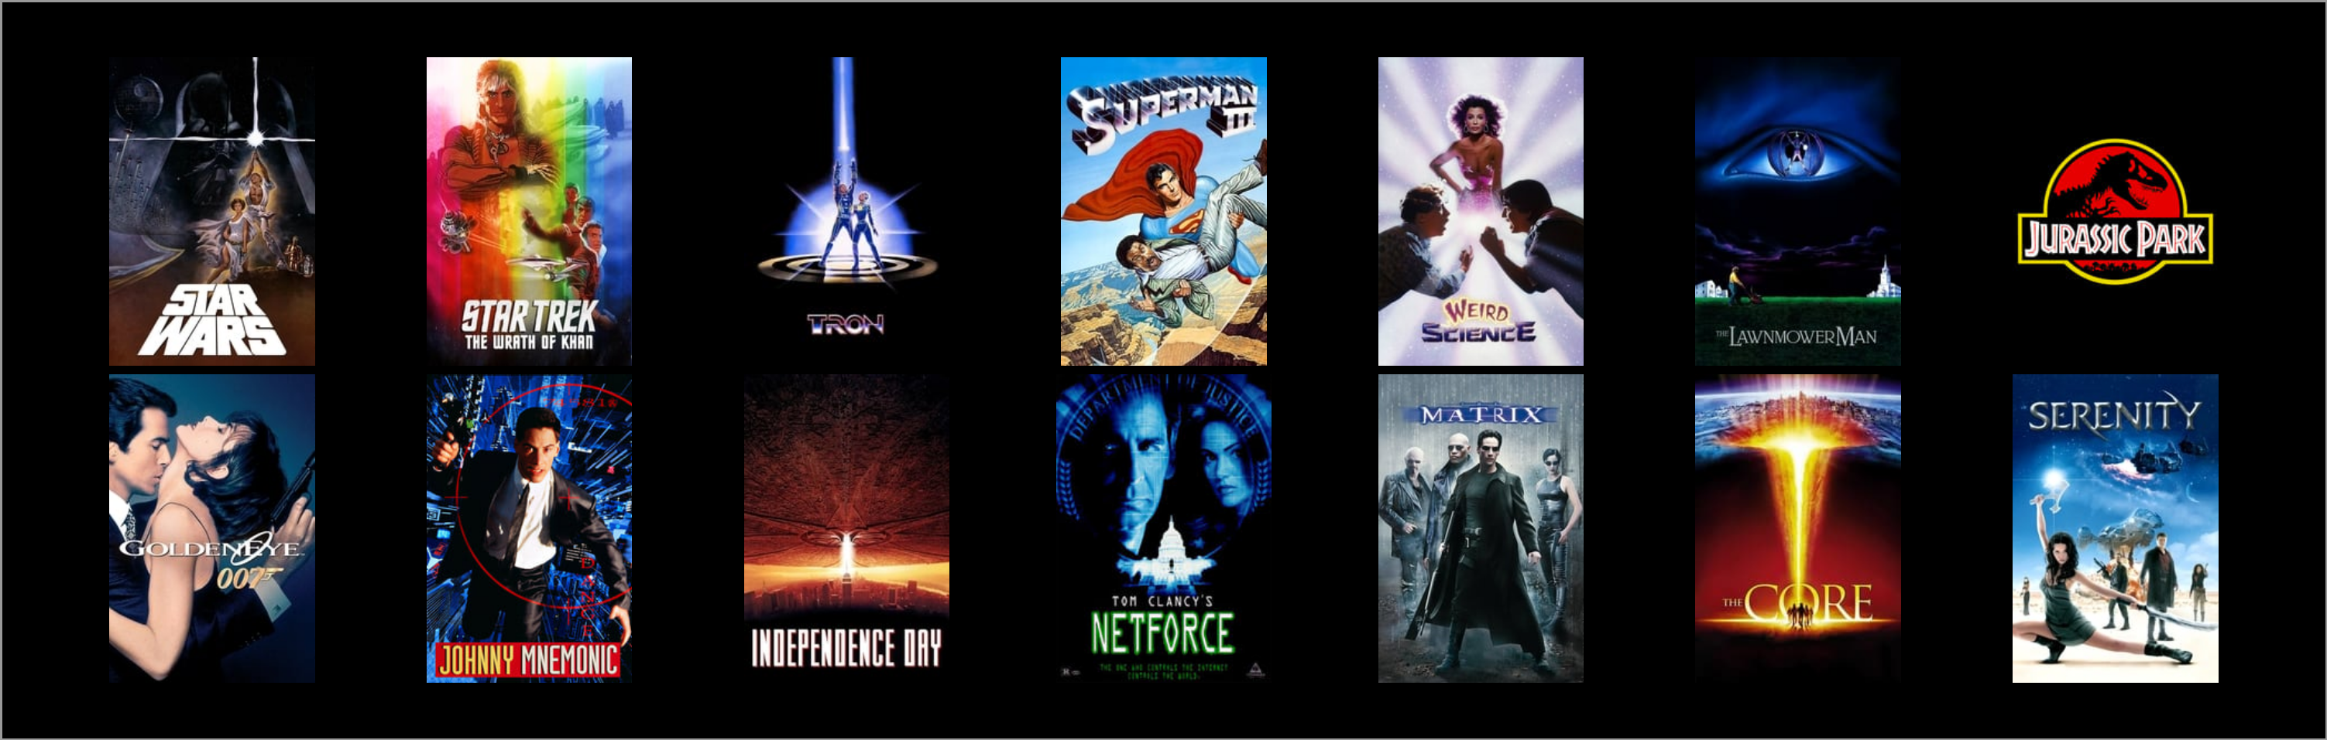
Genre: Sci-Fi
Notes:
Obviously the most fantastical use of hacking is in this genre
R2D2 twisting the “Scomp Link” (thanks wookiepedia)
Literally the whole of the Matrix trilogy
Kirk hacking into Khan’s ship to lower its shields in Star Trek II: The Wrath of Khan
Also the whole of Tron
This is what I mean by magic
Also more traditional portrayals of hacking
John Hughes’s Weird Science
About 2 boys frankensteining a sexy woman through the computer
Hack US military for power
Achieve the greatest single feat of misogyny since the death of Sean Connery

Slide 16
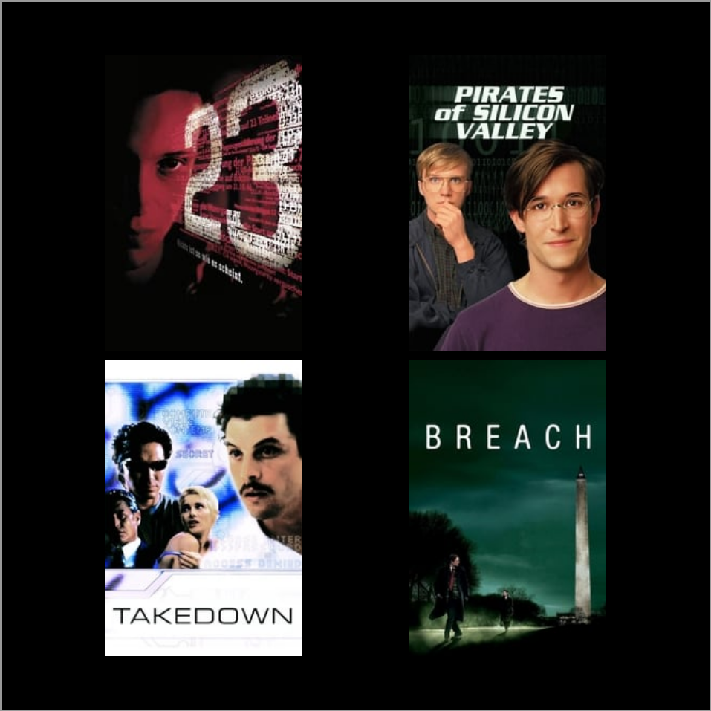
Genre: TrueLife
Notes:
Interesting in its depiction of hacking
*Needs* to get it right
Liberties taken to make a smooth and cohesive story (as with any based on a true story film)
Don’t think hacking serves much of a narrative purpose outside of being things that really happened
Also don’t have much of a social impact lol. I’ve seen something like Snowden but has anyone else?

Slide 17
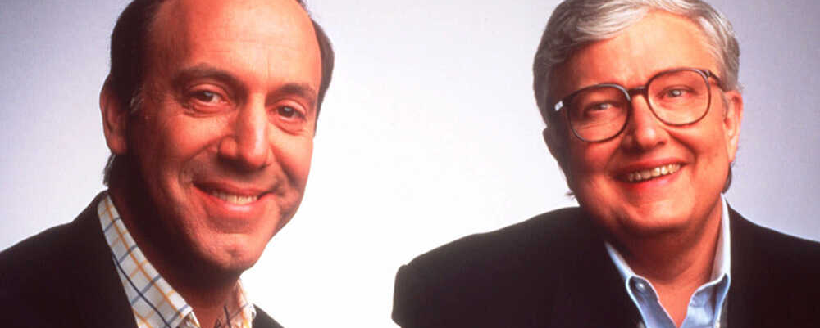
Let's Go To The Movies!
Notes:
Points to anyone who knows these guys
Gonna look at specific movies
Plot
Effect on culture
My personal takes
Looking mostly at hacker and sci fi movies here
Starting with one of the classics of the genre

Slide 18
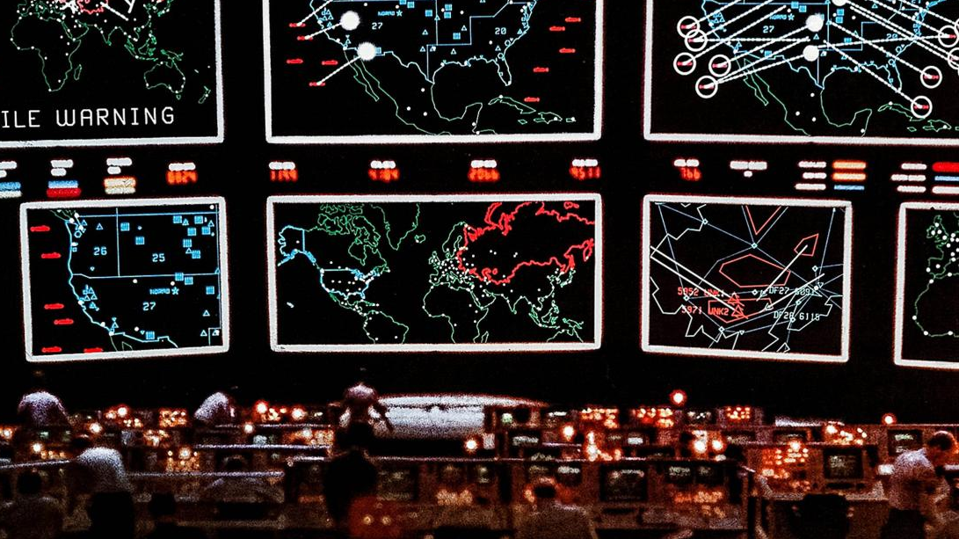
How About a Nice Game of Chess?
Notes:
WarGames!!!
1983 movie starring Matthew Broderick
David Lightman (Broderick) plays a high schooler
Hacks into school computer to change grades
Mistakenly hacks NORAD thinking it’s a games company
“Plays” new “game” (actually WOPR, new supercomouter)
Triggers countdown to Global Thermonuclear War

Slide 19
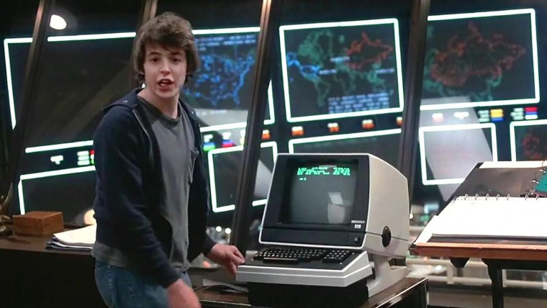
WarGames as Pioneer
Establishes Hollywood hacking tropes
Hacker culture impact
Surprisingly accurate, too!
Notes:
Typing dialogue
Unrealistic UI
“We’re in!!!”
The term “Wardialing” comes from this film
Calling everyone in a specific area code
Enumerated modems, computers, BBSes, faxes, etc.
Could capture vicemail greetings to guess passwords and user accounts
Also includes
Phreaking (telephone line manipulation)
Social engineering
Super accurate in a dial-up world

Slide 20
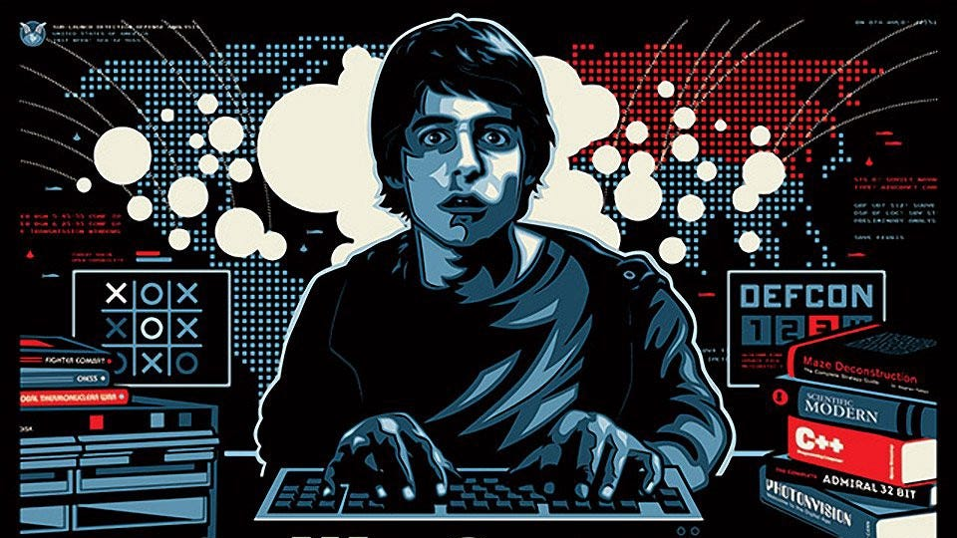
Cultural Impact
Pioneered depictions of the internet
Coined “Wardialing”
Increase in BBS Traffic
Notes:
First mainstream portrayal of the internet
Serving as a framework for early internet discussions in America
Bulletin Board Systems (BBS) Surge:
Film's influence on increased BBS activity
Introduction of viewers to modems through the movie

Slide 21
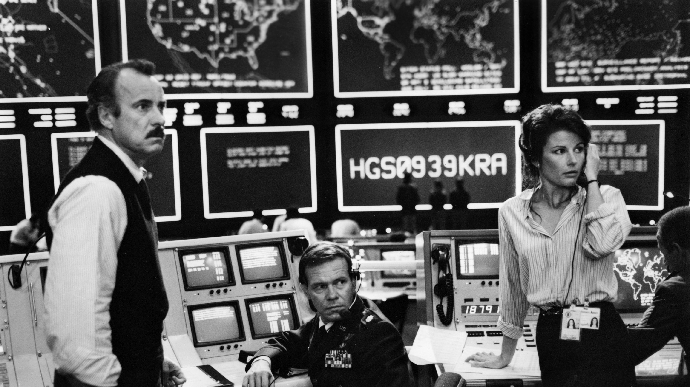
Legislative Impact
Ronald Reagan watched it…
Computer Fraud and Abuse Act 1986
Shaped perceptions – especially in the media
Notes:
Legislative Impact of the Film:
Influence on Ronald Reagan:
Reagan's connection to Lawrence Lasker
Reagan's query to joint chiefs after a private screening at Camp David
Resulting in National Security Decision Directive Number 145
National Security Decision Directive Number 145:
First presidential directive on cybersecurity in the US
NSA's control over government computer systems with sensitive information
Media Influence and Legislative Response:
Media's focus on the potential reality of a "WarGames scenario"
Impact on public perception towards hacking
Contribution to the passing of the Computer Fraud and Abuse Act of 1986
Significance to Cybersecurity Legislation:
Film's portrayal influencing the notion of unauthorized computer access as illegal
Connection to the foundation of the cybersecurity industry and its regulatory framework

Slide 22
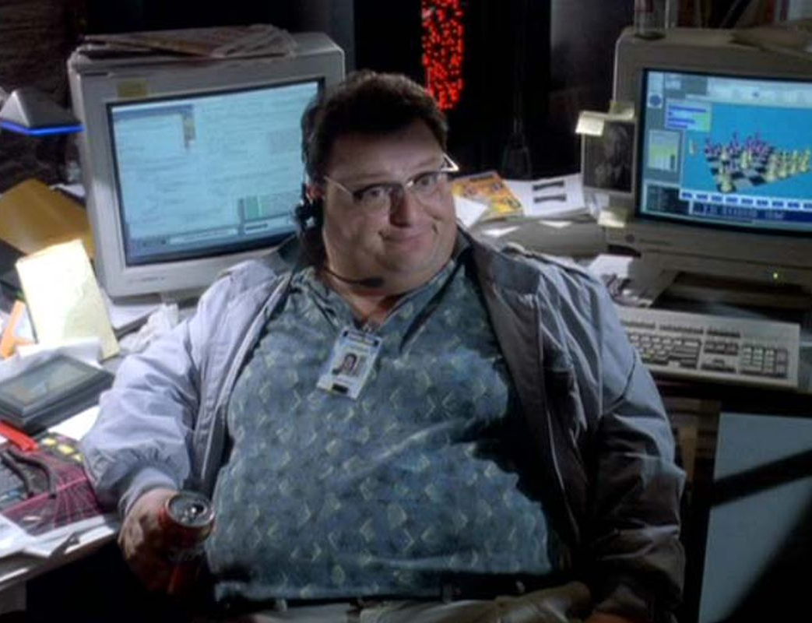
It’s a UNIX System…
Once the highest grossing film of all time
Dennis Nedry’s hacking is the inciting incident
A whole subreddit was born…
Notes:
Who doesn’t know Jurassic Park?
Isn’t it crazy he made this and Schindler’s list in the same year?
Dennis Nedry, IT guy on the sland, is approached by a rival company who wants to buy dinosaur embryos
Nedry shuts down the security systems.. Whoops! All Dinosaurs
The only fix is Lex, the kid hacker, manages to hack into Nedry’s terminal and save the day uttering the immortal words “It’s a UNIX System… I know this”

Slide 23
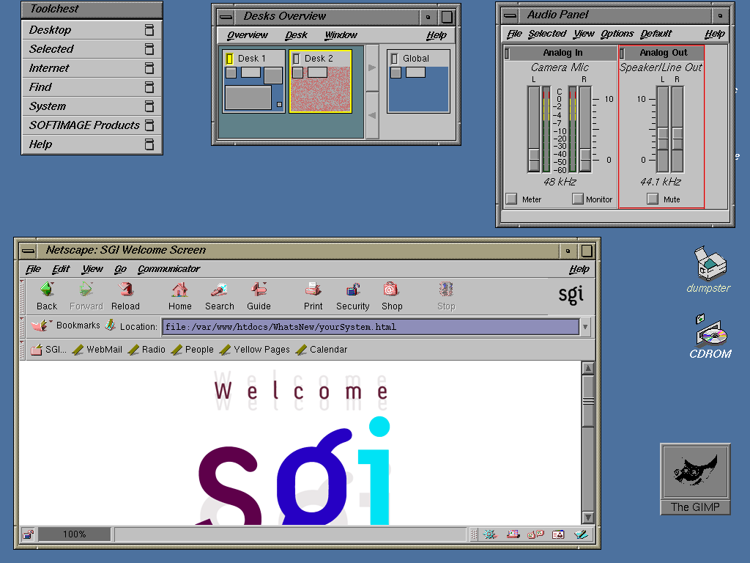
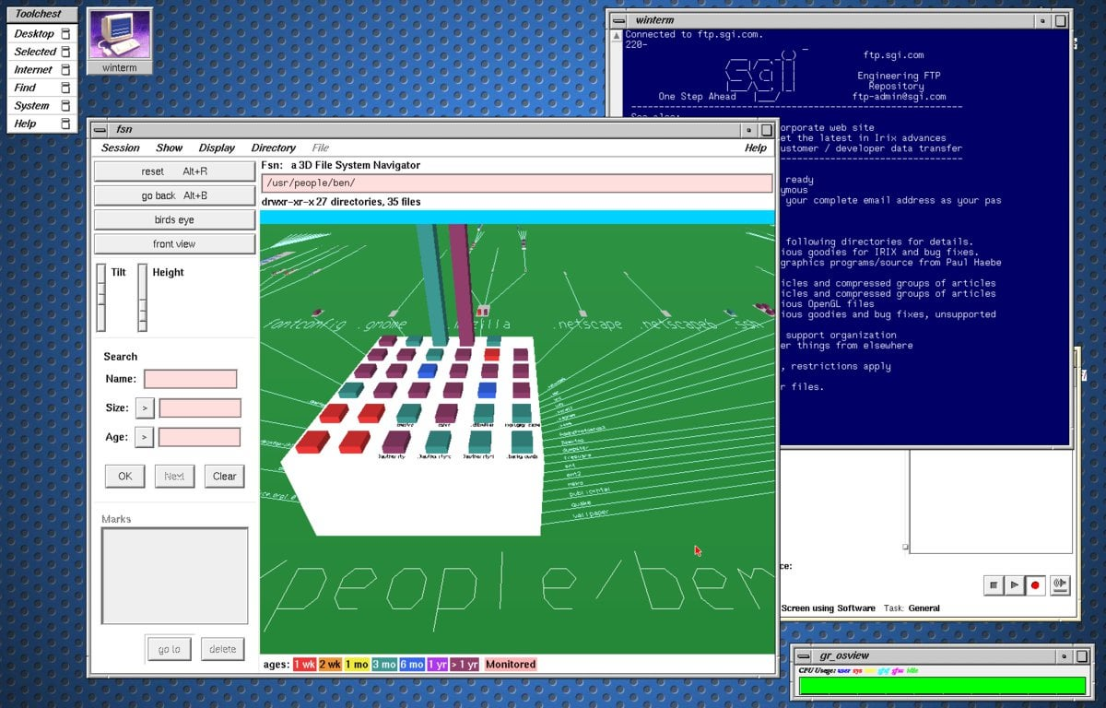
It Actually Is A UNIX System!
FSN on top of IRIX OS
Notes:
It is and was possible to have the Jurassic Park OS on your computer
IRIX is a derivative of Silicon Graphics in-house OS
FSN is a 3d filesystem that is downloadable on github
Not very useful but probably thematically accurate given who Nedry is
Still mystifies the audience, sensational…

Slide 24
Any Sufficiently Advanced Technology is Indistinguishable from Magic
WWW was only 3 years old
Hacking does the same thing as magic
Both saviour and threat?
Arthur C. Clarke
Notes:
General public didn’t have exposure to how computers worked
Parallels between hacking and magic are stark:
Representing abstract/boring concepts with interesting visuals
Unknown tools and elaborate rituals to advance the plot
Because hacking is real it reflects a broader growing trend in the late 80s and 90s
Saviour and threat
Look at Terminator as well
Could make parallels to the Satanic Panic

Slide 25
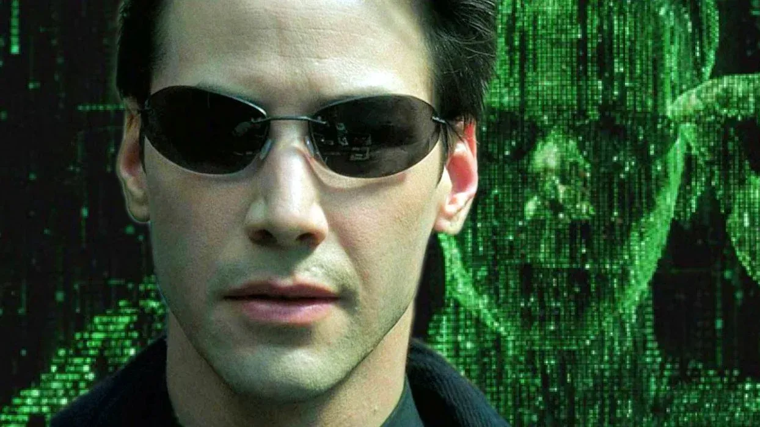
What Is Real?
Iconic Visuals
Public warnings against replication
Extremely significant themes
Notes:
I don’t think I need to say much about the influence that the Matrix has had on hacking in media
THE Hacking film
Green falling characters on black terminal
Black leather trench coats with rounded glasses
Typing furiously at keyboards and navigating virtual landscapes
Matrix: Reloaded
Scotland Yard teamed up with the BCS to issue a joint statement against:
“[Attempting] to emulate the [...] depiction of computer hacking”
Themes are significant to hacker culture more than broader culture
Basically about a digital insurgency against an oppressive overlord
Lots more deeper themes than this of course
This has always been the Hacker ethos IMO
Even if The Matrix didn’t really explore this
Do you know what movie did though?

Slide 26
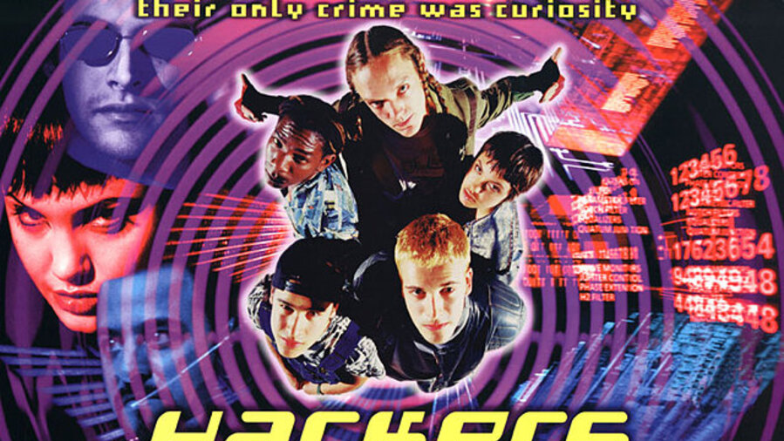
Hack the Planet!
Biggest Influence on Hacker Culture IMO
Notes:
When I told my manager at work about this talk he told me he became a hacker because of this film
The Plot:
High school hackers uncover corporate security chief's fraud scheme
Eugene "The Plague" Belford accuses them of attempting to steal his worm
He reports to the US Secret Service, claiming it's the daVinci worm
Alleges the hackers' involvement to capsize oil tankers for an ecological disaster

Slide 27
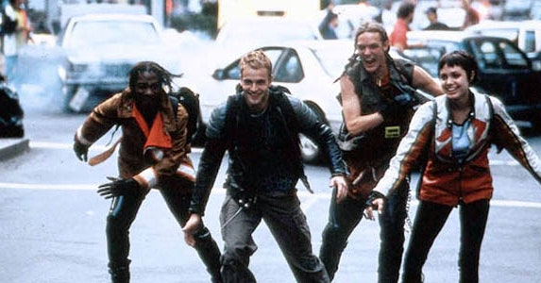
Hackers (1995)
Not ”good” per se
Iconic looks tho
Very cool movie
Notes:
The movie was not received well by critics or audiences
33% on RT for whatever that’s worth (nothing)
7.5 million on a budget of 20 million
Based on other movies that year though sounds like a flop of a year
Mel Gibson best director? Fuck off lol
The visual style informed the subculture just how the subculture informed the movie
Like an ouroboros of hacking with Angelina Jolie and Shaggy in there
Glamourous, stylized, positive outlook on hacking
Film depicted hacking as cool, inspiring young pre-hackers
Showed hackers as rebellious, countercultural figures
Represented with futuristic clothes, colorful hair, etc.
Brought hacker culture from forums to the mainstream
Limited commercial success but significant cultural impact
Referenced in an XKCD comic, indicative of its influence

Slide 28
Attacks in Film
Notes:
Kinds of attacks the movie industry has totally latched onto for one of a few reasons
More cinematic
Funnier
Easier to understand
Better at advancing the plot
Only kins of attacks a lot of people will know of (other than, like, viruses etc.)

Slide 29
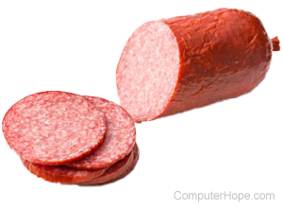
Salami Slicing Attacks
Repeatedly and frequently steal small amounts of money
Movies:
Superman III
Hackers
Office Space
Notes:
Say you work for a financial company that trades currencies
Current conversion rate is £1 to $1.224705.
For most intents and purposes the $0.004705 does not exist
Whats the harm in skimming that off?
Well I’m not here for philosophy I’m here for movies, but either way you slice it (ah? Get it?) its theft
People have done this IRL, normally people who maintain, like, travel fare boxes etc.
Movies:
Superman III: Richard Pryor embexzzles money from his employer Webscoe Industries, the CEO finds out and blackmails him – inciting incident ho
Hackers: The Plague creates a worm to steal $25 million from his employer, the main scheme of the antagonist here
Office Space: References Superman III – the protagonists try to steal some money from their employer bc theyre disgruntled but they steal too much

Slide 30
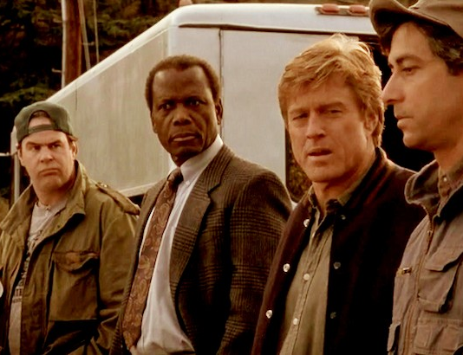
Social Engineering
Tricking people into doing something or giving something away
Involved in 98% of attacks
Movies:
Hot Millions
Sneakers
Hackers
Takedown
Notes:
Everyone knows this hopefully
Didn’t know the stat tho… debateable imho lmao
Movies:
Hot Millions: Marcus Pendleton social engineers other employees at the company he’s conning to embezzle money out of them
Sneakers: A movie I wish I had time to cover (It has fucking Sidney Poitier in it, first black man to win an Oscar, kind of beeath him imo lmao) anyway the eponymous sneakers need a voic command so arrange a date with the owner of the voice so they can say the command
Hackers: our hero Crash Override (the blonde guy from Trainspotting) manipulates a security guard to revealthe modem’s phone number to change the programme on a TV station
Takedown: Kevin Mitnick (RIP) was, whatever you think of him, a master social engineer, so this movie is full if it

Slide 31
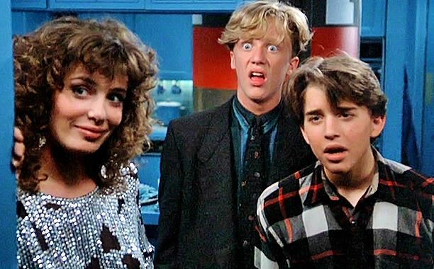
Fictional Hacktools
Your magic wand
Movies:
Weird Science
The Net
Sneakers
Notes:
If a hacker needs to do something there’s probably a Hacktool to do it lol
Contributes to script kiddies imo probs
With the right tool you can do whatever you want, hack the government with a click of a button, steal power, whatever.
Movies:
Weird Science: crypto-smasher is used to break into the grid to power their… woman manufacturing operation
The Net: GateKeeper grants users illegitimate access to government and military computer systems
Sneakers: The whole film revlves around an algorithm capable of decoding any code

Slide 32
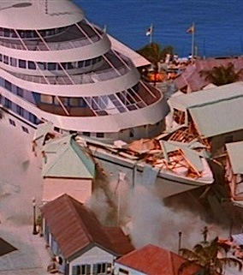
Insider and Outsider Attacks
Insider attacks fairly rare in movies
Movies:
Jurassic Park
Speed 2: Cruise Control
Office Space
Notes:
About a 50/50 split IRL apparently
Probably bullshit lol
Disgruntled employee trope *works*… is it engaging? No… unless youre fucking Steven Spielberg
Movies
Jurassic Park: Dennis Nedry
Speed 2: Cruise Control: John Geiger, who designs a cruise ship’s computer system, plans to take over the ship to steal diamonds. Isn’t that such a fucking funny title???
Office Space: already covered

Slide 33
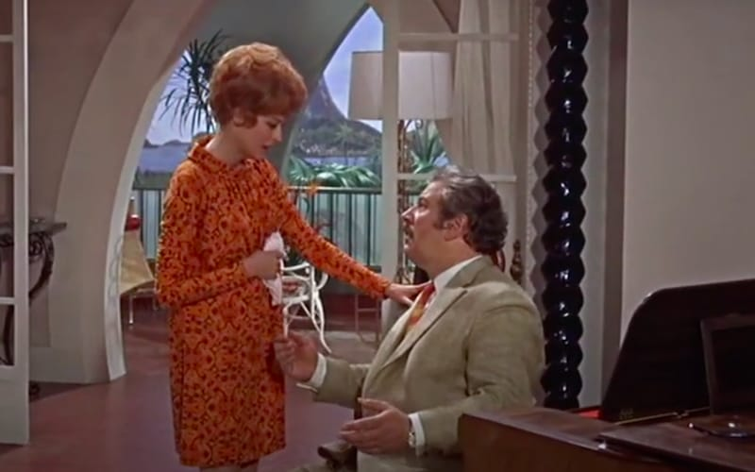
Password Discovery
It’s… disovering passwords… like?
Lot of movies use Swordfish as a password
Movies:
WarGames
Terminal Entry
Hot Millions
Notes:
Self explanatory really
Swordfish is because of a Marx Brothers movie (Horse Feathers) where a guy tries to get into a speakeasy with the password Swordfish. It’s used in Hackers, The Net, and Swordfish (duh)
Movies:
WarGames: David researches the system’s developer to discover a likely password for a backdoor
Terminal Entry: Hacker Bob uses brute forcing to hack an online game
Hot Millions: Marcus Pendleton uses shoulder surfing to determine a system’s password (mamn this movie was ahead of its time huh?)

Slide 34
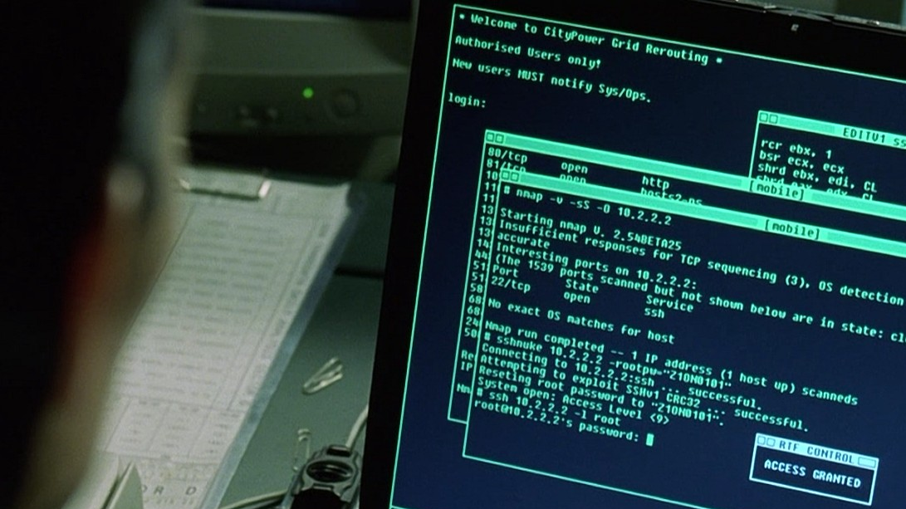
Nmap
Matrix: Reloaded
Oceans 8
Snowden
Dredd
Battle Royale
Others
HaXXXor: no Longer Floppy
Notes:
Found this out on Monday
Nmap keeps a list of movies the tool is seen in
Matrix Reloaded: first mainstream usage of nmap to find a vulnerable SSH server attached to a power grid
Snowden: Snowden beats an exam slated to take 5-8 hours in 38 minutes with an Nmap NSE script (great advertisng lol)
Dredd: Dredd uses nmap for network recon and exploitation of Peach Trees Tower, and to eventually get to MaMa
Battle Royale: Nmap source code can be seen beijng referenced by a hacker student. He later gets fucking blasted away crazy style
Elysium, Die Hard 4, The Bourne Ultimatum, and The Girl With The Dragon Tattoo also all feature nmap
The funniest, though, is:
HaXXXor: no Longer Floppy: an adult film where the model and actress E-Lita explains to her… friend how to use Nmap. Unfortunately a full penetration test is not performed… well… lol.

Slide 35
Questions?

